Slide 1

ENGINEERING CHEMISTRY
HARISH N
Department of Science and Humanities

Slide 2

ENGINEERING CHEMISTRY
Module 7- Functional materials-Polymers
Class content:
Molecular weight of polymers
Number average molecular weight
Weight average molecular weight
Viscosity average molecular weight

Slide 3
ENGINEERING CHEMISTRY
Module 7- Functional materials-Polymers
Molecular weight of Polymers
Polymers are a mix of chains of different lengths
Weight of polymers is expressed as an average molecular weight
The molecular weight is an important characteristic of a polymer sample as several properties of polymers depend on the molecular weight
The entire range of mechanical properties like stress-strain, impact, fracture, fatigue, creep, stress relaxation and cracking are influenced by average molecular weight and molecular weight distribution

Slide 4
ENGINEERING CHEMISTRY
Module 7- Functional materials-Polymers
Number average molecular weight
Weight average molecular weight
Average molecular weight
Viscosity average molecular weight

Slide 5
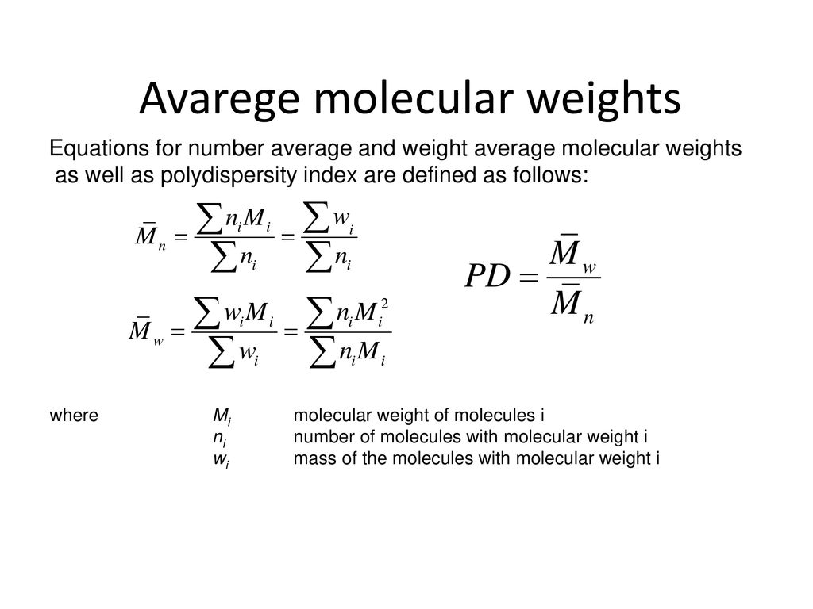


ENGINEERING CHEMISTRY
Module 7- Functional materials-Polymers
Number average molecular weight,
Obtained by dividing the total weight of the dispersed material with the total number of polymer units present
where n_{1,} n₂, n₃ …. are number of polymer units having molecular weights M₁, M₂, M_{3,}…. respectively
where n_{i} is the number of polymer units of molecular mass M_{i}
It depends only on number of polymer units and not their size
Colligative properties like osmotic pressure, elevation in boiling point or depression in melting point is used to determine number average molecular weight

Slide 6
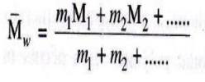
ENGINEERING CHEMISTRY
Module 7- Functional materials-Polymers
Weight average molecular weight,
It gives representation to various molecular species in
proportion to their masses in the given material
In the averaging process, the molecular weight of each
individual species is multiplied by its mass
where m_{1,} m₂, m₃ …. are masses of polymer units having molecular weights M₁, M₂, M₃ respectively

Slide 7
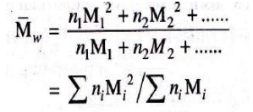
ENGINEERING CHEMISTRY
Module 7- Functional materials-Polymers
if n_{1,} n₂, n₃ …. are number of polymer units having
molecular weights M₁, M₂, M₃ respectively
then m₁ = n₁M₁, m₂ = n₂ M₂ ….
Weight average molecular weight can be written as
It depends on size of the polymer units
Properties which depend on size like sedimentation
velocity or light scattering are used to determine weight
average molecular weight

Slide 8
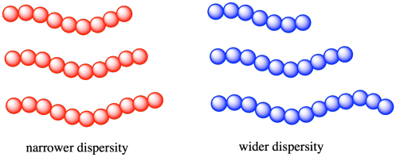
ENGINEERING CHEMISTRY
Module 7- Functional materials-Polymers
The ratio is called the polydispersity index (PDI)
It is a measure for the broadness of a molecular weight distribution of a polymer, that is, the larger the polydispersity index, the broader the molecular weight distribution
A monodisperse polymer where all the chain lengths are equal has PDI =1
PDI > 1, shows that the polymeric sample is less homogeneous and polydisperse
Source:http://employees.csbsju.edu/cschaller/Advanced/Polymers/CPmw.html

Slide 9
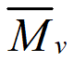
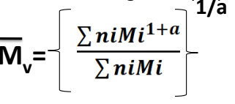
ENGINEERING CHEMISTRY
Module 7- Functional materials-Polymers
Viscosity average molecular weight,
a is the Mark- Houwink parameter
its value depends on the polymer- solvent system at a particular temperature and is 0.5≤ a ≤ 0.9
Viscosity average molecular weight is closer to weight average molecular weight as larger molecules contribute more to viscosity

Slide 10
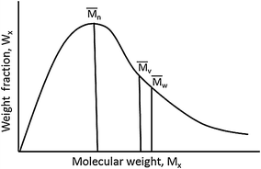
ENGINEERING CHEMISTRY
Module 7- Functional materials-Polymers
Molecular weight distribution curve
Source:https://link.springer.com/chapter/10.1007/978-3-642-38730-2_2
> >

Slide 11
ENGINEERING CHEMISTRY
Module 7- Functional materials-Polymers
End of Module 7

Slide 12
THANK YOU
HARISH N
Department of Science and Humanities
harishn@pes.edu

